Slide 1
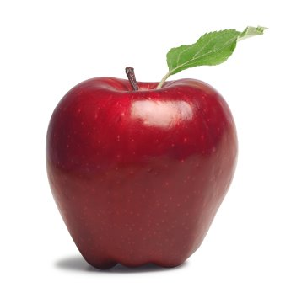
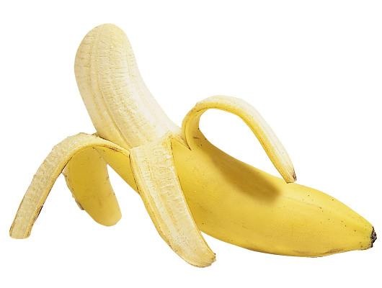
How are these the same? How are these different?

Slide 2
How are these the same? How are these different?

Slide 3
How are these the same? How are these different?

Slide 4
How are these the same? How are these different?

Slide 5
How are these the same? How are these different?

Slide 6
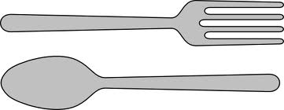
How are these the same? How are these different?

Slide 7
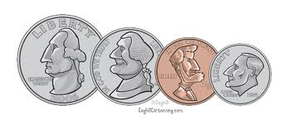
How are these the same? How are these different?

Slide 8
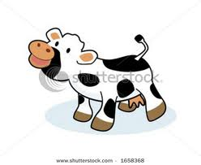
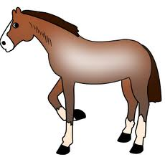
How are these the same? How are these different?

Slide 9
How are these the same? How are these different?

Slide 10
How are these the same? How are these different?

Slide 11
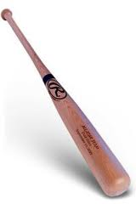
How are these the same? How are these different?

Slide 12
How are these the same? How are these different?

Slide 13
How are these the same? How are these different?

Slide 14
How are these the same? How are these different?

Slide 15
How are these the same? How are these different?

Slide 16
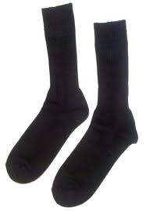
How are these the same? How are these different?

Slide 17
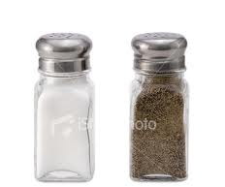
How are these the same? How are these different?

Slide 18
How are these the same? How are these different?

Slide 19
